Slide 1


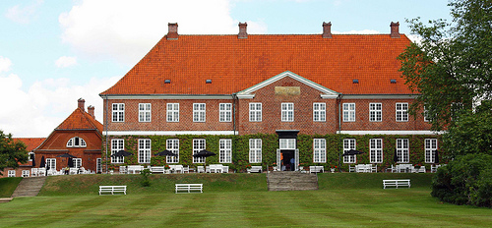
Free energy and active inference
Karl Friston, University College London
How much about our interaction with – and experience of – our world can be deduced from basic principles? This talk reviews recent attempts to understand the self-organised behaviour of embodied agents – like ourselves – as satisfying basic imperatives for sustained exchanges with our world. In brief, one simple driving force appears to explain nearly every aspect of our behaviour and experience. This driving force is the minimisation of surprise or prediction error. In the context of perception, this corresponds to (Bayes-optimal) predictive coding that suppresses exteroceptive prediction errors. In the context of action, simple reflexes can be seen as suppressing proprioceptive prediction errors. We will look at some of the phenomena that emerge from this formulation, such as hierarchical message passing in the brain and the perceptual inference that ensues. I hope to illustrate these points using simple simulations of perception, action and the perception of action.

Slide 2

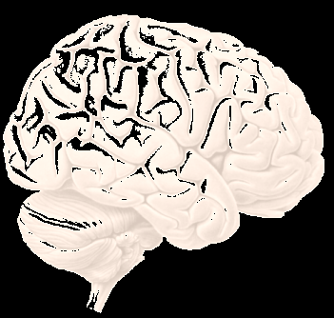
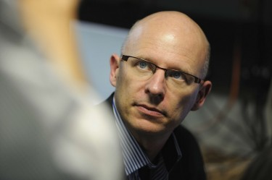
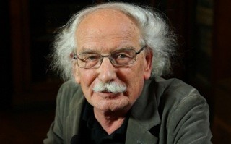
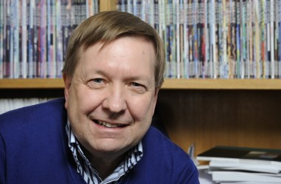
Overview
The anatomy of inference predictive coding
hierarchical models
canonical microcircuits
Action and perception perceptual synthesis and violations
action and its observation
dopamine and perseveration

Slide 3
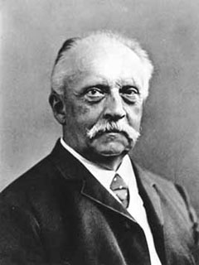
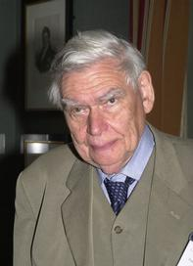
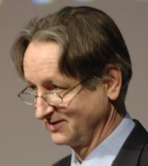
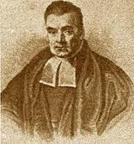

“Objects are always imagined as being present in the field of vision as would have to be there in order to produce the same impression on the nervous mechanism” - von Helmholtz
Hermann von Helmholtz
Richard Gregory
Geoffrey Hinton
The Helmholtz machine and the Bayesian brain
Thomas Bayes
Richard Feynman

Slide 4
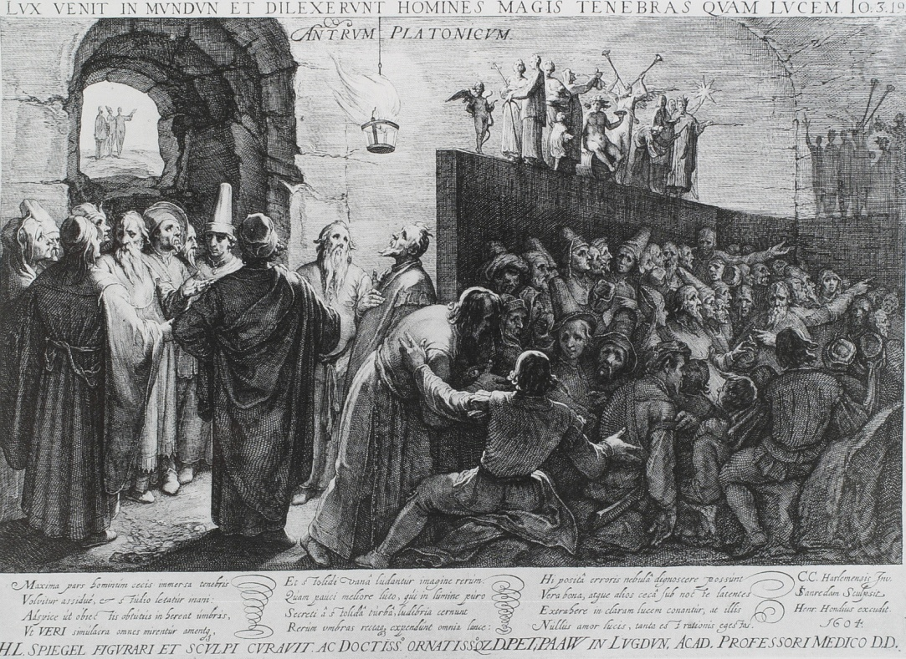
“Objects are always imagined as being present in the field of vision as would have to be there in order to produce the same impression on the nervous mechanism” - von Helmholtz
Hermann von Helmholtz
sensory impressions…
Richard Gregory
Plato: The Republic (514a-520a)

Slide 5
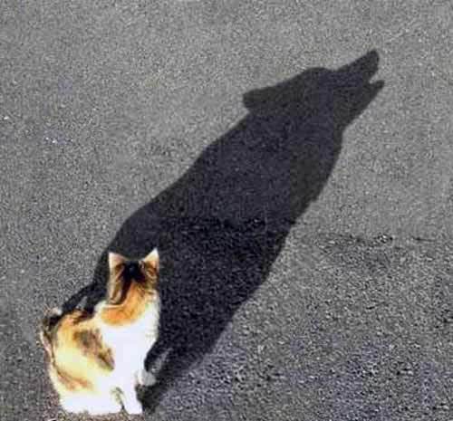
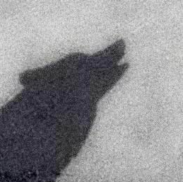

Bayesian filtering and predictive coding
changes in expectations are predicted changes and (prediction error) corrections
prediction error

Slide 6
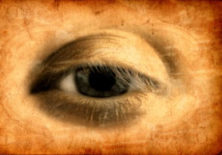
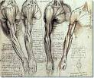
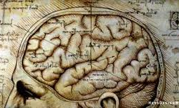
Minimizing prediction error
sensations – predictions
Prediction error
Action
Perception
Change sensations
Change predictions

Slide 7
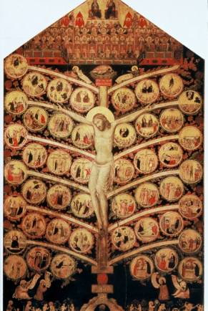
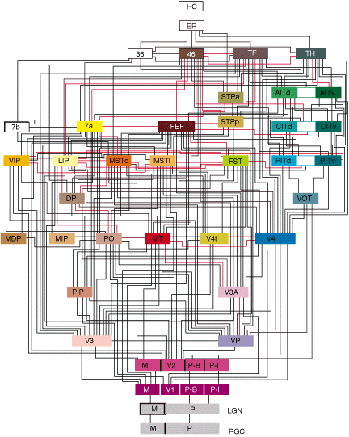
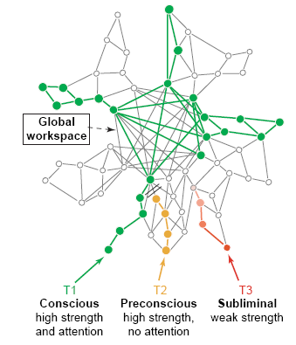

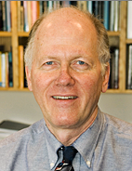
Neuronal hierarchies and hierarchical models
lateral
Backward
(nonlinear)

Slide 8
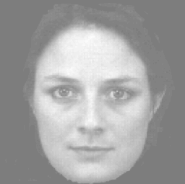
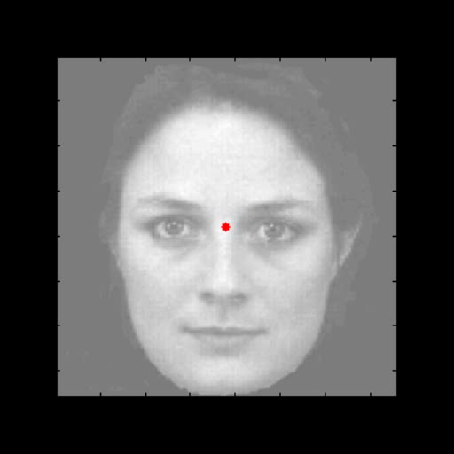

Generative models
A simple hierarchy
what
where
Sensory fluctuations

Slide 9
From models to perception
A simple hierarchy
Generative model
Descending
predictions
Model inversion (inference)
Predictive coding
Expectations:
Ascending prediction errors
Predictions:
Prediction errors:

Slide 10
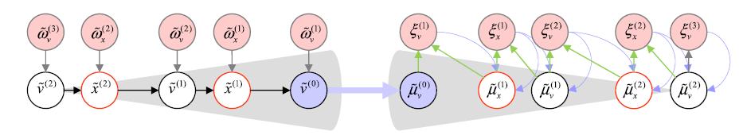
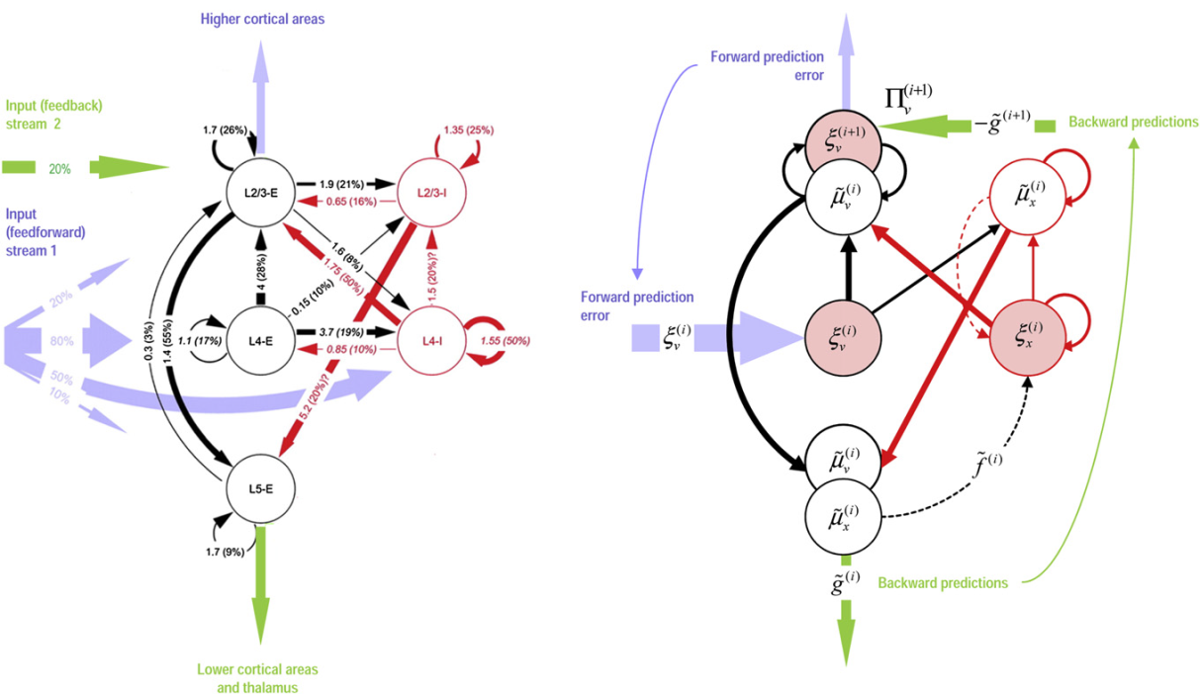
Canonical microcircuits for predictive coding
Haeusler and Maass: Cereb. Cortex 2006;17:149-162
Bastos et al: Neuron 2012; 76:695-711

Slide 11

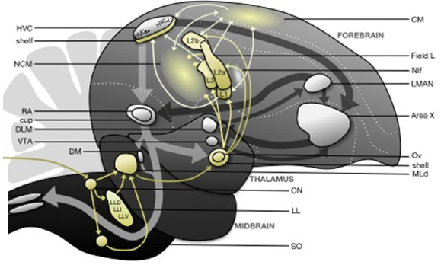
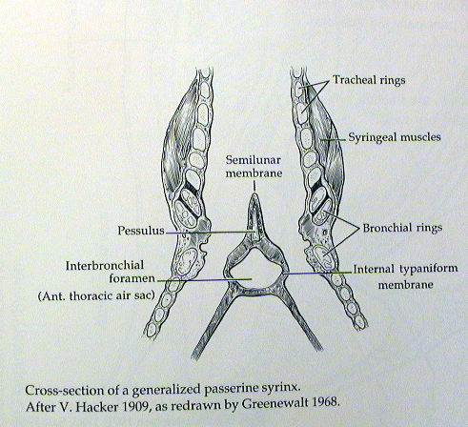
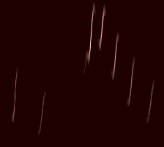
David Mumford
Predictive coding and active inference
Perception
Prediction error (superficial pyramidal cells)
Higher vocal centre
Expectations (deep pyramidal cells)
Area X
Hypoglossal Nucleus
Thalamus
Action

Slide 12
Prediction error can be reduced by changing predictions (perception)
Prediction error can be reduced by changing sensations (action)
Hierarchical predictive coding is a neurobiological plausible scheme for (approximate) Bayesian inference about the causes of sensations – by minimising prediction error
Predictive coding requires the dual encoding of expectations and errors, with reciprocal (neuronal) message passing
Much of the known neuroanatomy and neurophysiology of cortical architectures is consistent with the requisite message passing

Slide 13
Overview
The anatomy of inference predictive coding
hierarchical models
canonical microcircuits
Action and perception perceptual synthesis and violations
action and its observation
dopamine and perseveration

Slide 14
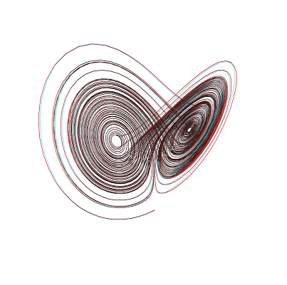



Perceptual inference and sequences of sequences
Neuronal hierarchy
Syrinx
sonogram
Frequency (KHz)
0.5
1
1.5
Time (sec)
External states
Sensory states
Internal states
Prediction error

Slide 15

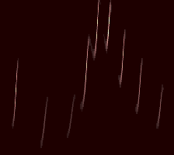
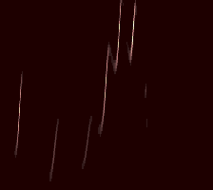
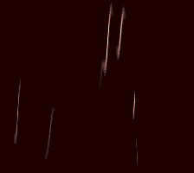
4500
4000
3500
Frequency (Hz)
3000
2500
stimulus (sonogram)
without last syllable
omission and violation of predictions
4500
4000
3500
Frequency (Hz)
3000
2500
percept
percept
0.5
1
1.5
0.5
1
1.5
Time (sec)
Time (sec)
ERP (prediction error)
with omission
100
100
50
50
Stimulus but no percept
0
0
LFP (micro-volts)
LFP (micro-volts)
-50
-50
Percept but no stimulus
-100
500
1000
1500
2000
-100
500
1000
1500
2000
peristimulus time (ms)
peristimulus time (ms)

Slide 16
Overview
The anatomy of inference predictive coding
hierarchical models
canonical microcircuits
Action and perception perceptual synthesis and violations
action and its observation
dopamine and perseveration

Slide 17
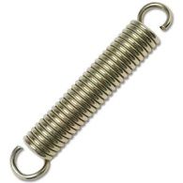
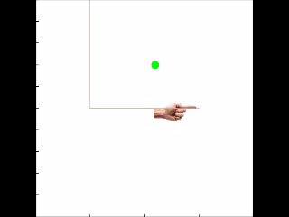
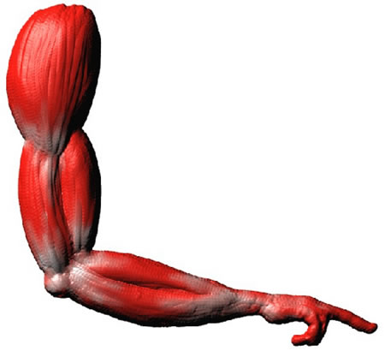
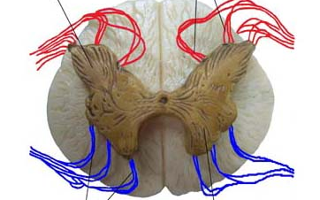
Action with point attractors
visual input
Descending
proprioceptive predictions
proprioceptive input

Slide 18
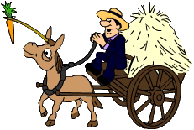
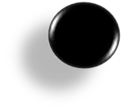
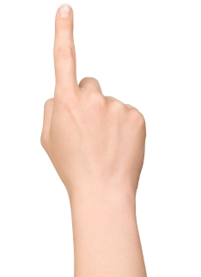
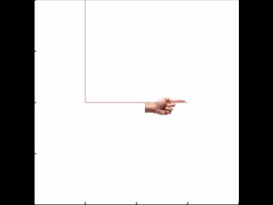
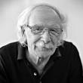
Action with heteroclinic orbits
Descending
proprioceptive predictions
action
observation
0.4
0.6
0.8
position (y)
1
1.2
1.4
0
0.2
0.4
0.6
0.8
1
1.2
1.4
0
0.2
0.4
0.6
0.8
1
1.2
1.4
position (x)
position (x)

Slide 19
Overview
The anatomy of inference predictive coding
hierarchical models
canonical microcircuits
Action and perception perceptual synthesis and violations
action and its observation
dopamine and perseveration

Slide 20
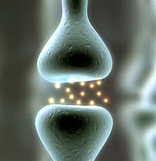


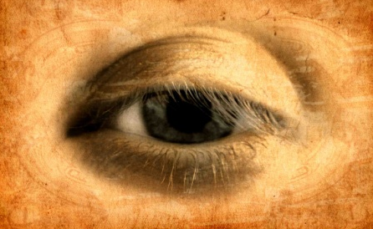
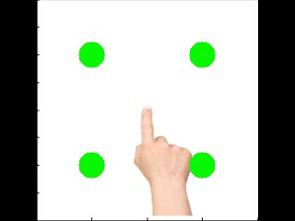
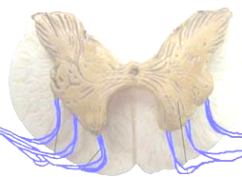
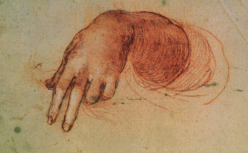
Dopamine and precision
Motor cortex
Parietal cortex
Premotor cortex
Prefrontal cortex
Striatum
Mesocortical DA projections
Superior colliculus
Nigrostriatal DA projections
SN/VTA
Mesorhombencephalic pathway
Motoneurones
Notes:
20

Slide 21
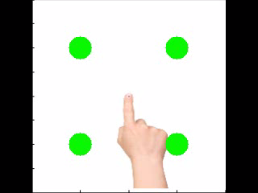




Dopamine and perseveration
perseveration
confusion
Motor cortex
Motor cortex
Premotor cortex
Premotor cortex
Superior colliculus
SN/VTA
Superior colliculus
SN/VTA

Slide 22
Hermann von Helmholtz
“Each movement we make by which we alter the appearance of objects should be thought of as an experiment designed to test whether we have understood correctly the invariant relations of the phenomena before us, that is, their existence in definite spatial relations.”
‘The Facts of Perception’(1878) in The Selected Writings of Hermann von Helmholtz, Ed. R. Karl, Middletown: Wesleyan University Press, 1971 p. 384

Slide 23
Thank you
And thanks to collaborators:
Rick Adams
Andre Bastos
Sven Bestmann
Harriet Brown
Jean Daunizeau
Mark Edwards
Xiaosi Gu
Lee Harrison
Stefan Kiebel
James Kilner
Jérémie Mattout
Rosalyn Moran
Will Penny
Lisa Quattrocki Knight
Klaas Stephan
And colleagues:
Andy Clark
Peter Dayan
Jörn Diedrichsen
Paul Fletcher
Pascal Fries
Geoffrey Hinton
Allan Hobson
James Hopkins
Jakob Hohwy
Henry Kennedy
Paul Verschure
Florentin Wörgötter
And many others

Slide 24
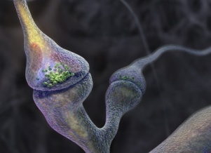
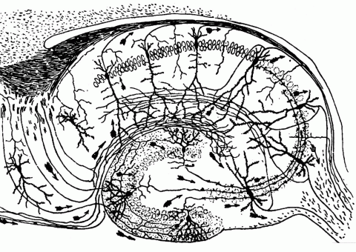
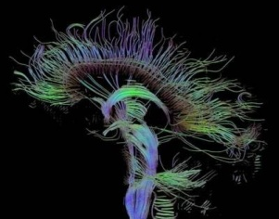
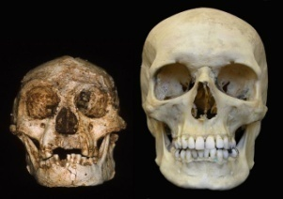
Time-scale
Free-energy minimisation leading to…
Perception and Action: The optimisation of neuronal and neuromuscular activity to suppress prediction errors (or free-energy) based on generative models of sensory data.
Learning and attention: The optimisation of synaptic gain and efficacy over seconds to hours, to encode the precisions of prediction errors and causal structure in the sensorium. This entails suppression of free-energy over time.
Neurodevelopment: Model optimisation through activity-dependent pruning and maintenance of neuronal connections that are specified epigenetically
Evolution: Optimisation of the average free-energy (free-fitness) over time and individuals of a given class (e.g., conspecifics) by selective pressure on the epigenetic specification of their generative models.

Slide 25
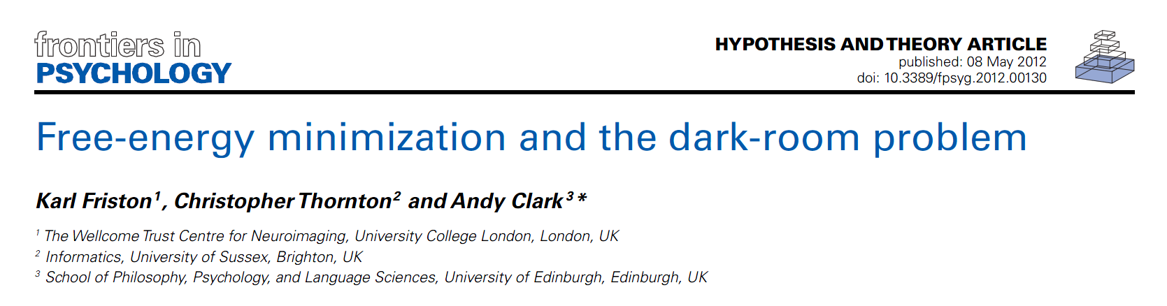

Searching to test hypotheses – life as an efficient experiment
Free energy principle
minimise uncertainty

